Slide 1
Computer Security Risks

Slide 2
Objectives Overview
Define the term, computer security risks, and briefly describe the types of cybercrime perpetrators
Discuss techniques to prevent unauthorized computer access and use
Identify safeguards against hardware theft and vandalism
Explain the ways software manufacturers protect against software piracy
Discuss how encryption works, and explain why it is necessary
Describe various types of Internet and network attacks, and identify ways to safeguard against these attacks

Slide 3
Computer Security Risks
A computer security risk is any event or action that could cause a loss of or damage to computer hardware, software, data, information, or processing capability
A cybercrime is an online or Internet-based illegal act
Hackers
Crackers
Script Kiddies
Corporate Spies
Unethical Employees
Cyberextortionists
Cyberterrorists

Slide 4
Computer Security Risks
Hackers : refers to someone who accesses a computer or network illegally.
Crackers: is someone who accesses a computer or network illegally but has the intent of destroying data, stealing information, or other malicious action
Script Kiddies: A script kiddie has the same intent as a cracker but does not have the technical skills and knowledge. Script kiddies often are teenagers that use prewritten hacking and cracking programs to break into computers

Slide 5
Computer Security Risks
Corporate Spies: have excellent computer and network skills and are hired to break into a specific computer and steal its proprietary data and information.
Unethical Employees: break into their employers’ computers for a variety of reasons. Some simply want to exploit a security weakness. Others seek financial gains from selling confidential information. Disgruntled employees may want revenge

Slide 6
Computer Security Risks
Cyberextortionists : is someone who uses e-mail as a vehicle for extortion. They send a company a threatening e-mail message indicating they will expose confidential information, exploit a security flaw, or launch an attack that will compromise the company’s network — if they are not paid a sum of money
Cyberterrorists: is someone who uses the Internet or network to destroy or damage computers for political reasons. The extensive damage might destroy the nation’s air traffic control system, electricity-generating companies, or a telecommunications infrastructure

Slide 7
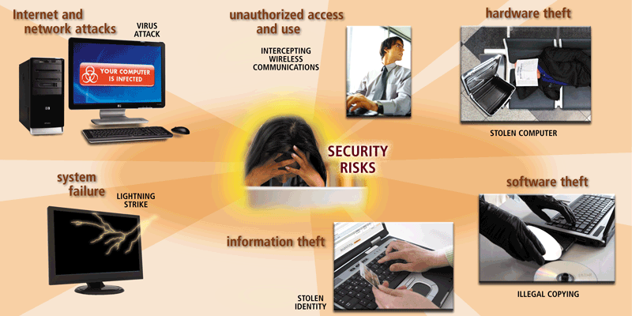
Computer Security Risks

Slide 8
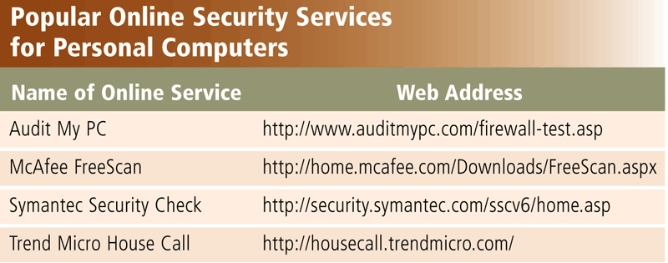
Internet and Network Attacks
Information transmitted over networks has a higher degree of security risk than information kept on an organization’s premises
An online security service is a Web site that evaluates your computer to check for Internet and e-mail vulnerabilities

Slide 9
Internet and Network Attacks
Computer Virus
Affects a computer negatively by altering the way the computer works
Worm
Copies itself repeatedly, using up resources and possibly shutting down the computer or network
Trojan Horse
A malicious program that hides within or looks like a legitimate program
Rootkit
Program that hides in a computer and allows someone from a remote location to take full control

Slide 10
Malwares
Computer viruses, worms, and Trojan horses are classified as malware (short for malicious software), programs that act without a user’s knowledge and deliberately alter the computer’s operations.
Unscrupulous programmers write malware and then test it to ensure it can deliver its payload. The payload is the destructive event or prank the program is intended to deliver.

Slide 11
Internet and Network Attacks
An infected computer has one or more of the following symptoms:
Operating system runs much slower than usual
Available memory is less than expected
Files become corrupted
Screen displays unusual message or image
Music or unusual sound plays randomly
Existing programs and files disappear
Programs or files do not work properly
Unknown programs or files mysteriously appear
System properties change
Operating system does not start up
Operating system shuts down unexpectedly

Slide 12
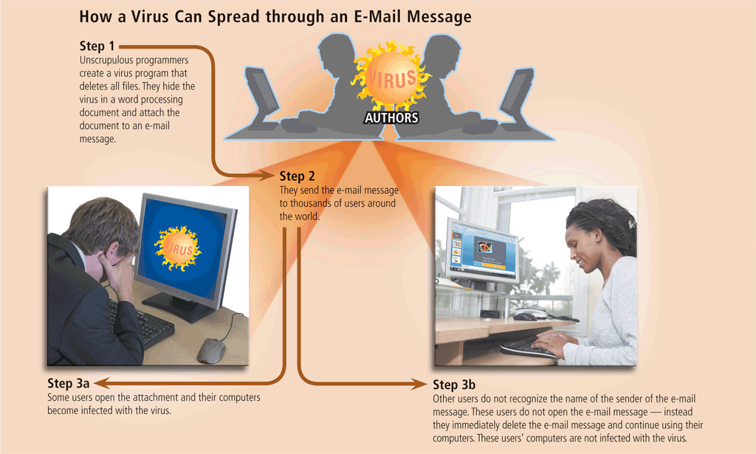
Page 559
Figue 11-3

Slide 13
Antivirus
An antivirus program protects a computer against viruses by identifying and removing any computer viruses found in memory, on storage media, or on incoming files.
A quarantine is a separate area of a hard disk that holds the infected file until the infection can be removed. This step ensures other files will not become infected.

Slide 14
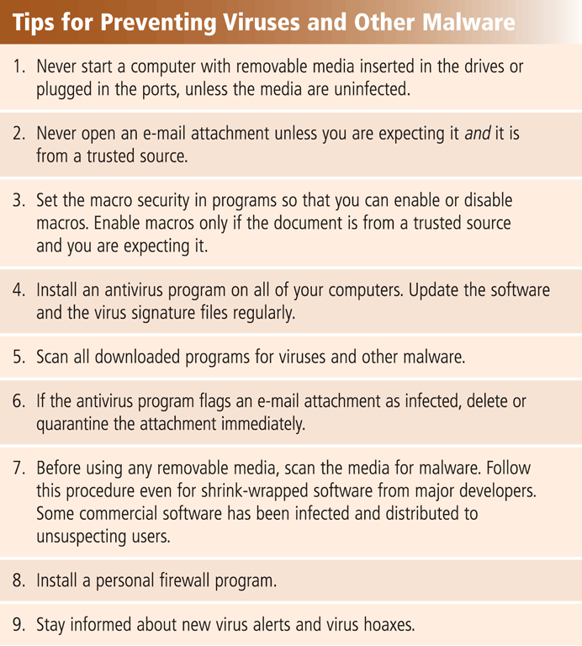
How to Safeguard against Malwares
Users can take several precautions to protect their home and work computers and mobile devices from these malicious infections.

Slide 15
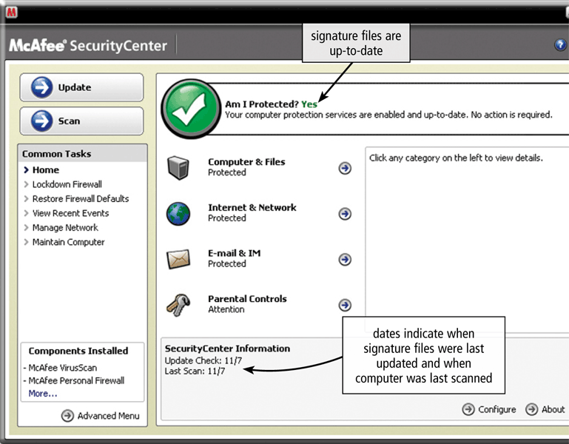

Slide 16
Internet and Network Attacks
A botnet is a group of compromised computers connected to a network
A compromised computer is known as a zombie
A denial-of-service attack (DoS attack) disrupts computer access to Internet services
A back door is a program or set of instructions in a program that allow users to bypass security controls
Spoofing is a technique intruders use to make their network or Internet transmission appear legitimate

Slide 17
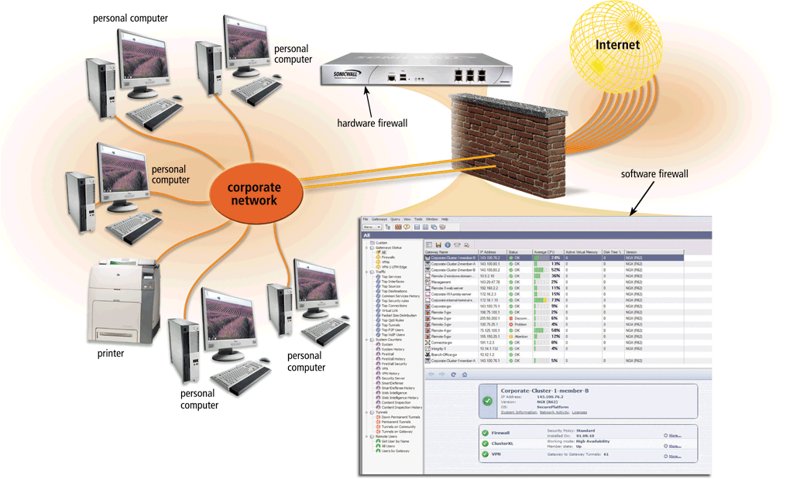
Internet and Network Attacks
A firewall is hardware and/or software that protects a network’s resources from intrusion

Slide 18
Internet and Network Attacks
Intrusion detection software
Analyzes all network traffic
Assesses system vulnerabilities
Identifies any unauthorized intrusions
Notifies network administrators of suspicious behavior patterns or system breaches

Slide 19
Unauthorized Access and Use
Unauthorized access is the use of a computer or network without permission
Unauthorized use is the use of a computer or its data for unapproved or possibly illegal activities

Slide 20
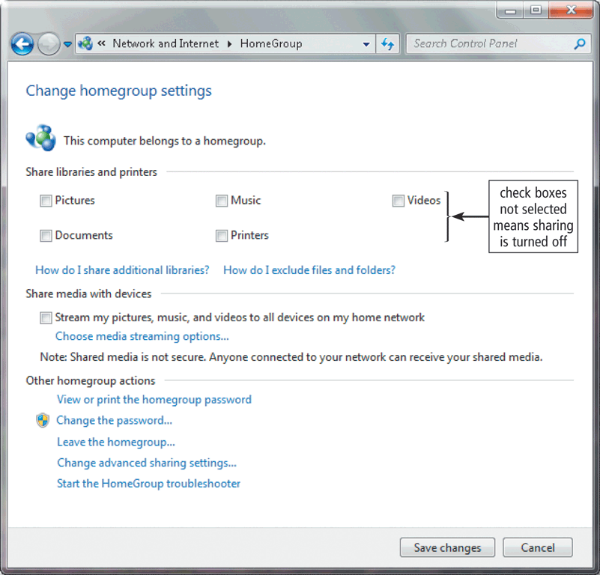
Unauthorized Access and Use
Organizations take several measures to help prevent unauthorized access and use
Acceptable use policy
Disable file and printer sharing
Firewalls
Intrusion detection software

Slide 21
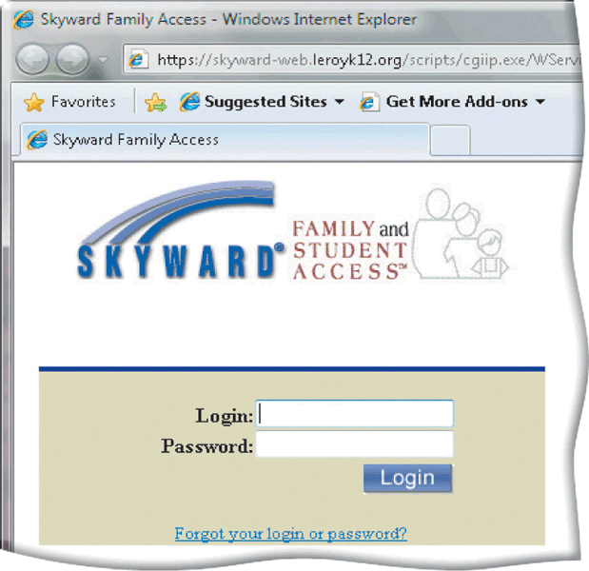
Unauthorized Access and Use
Access controls define who can access a computer, when they can access it, and what actions they can take
Two-phase processes called identification and authentication
User name
Password
CAPTCHA
Notes:
(Completely Automated Public Turing test to tell Computers and Humans Apart)

Slide 22
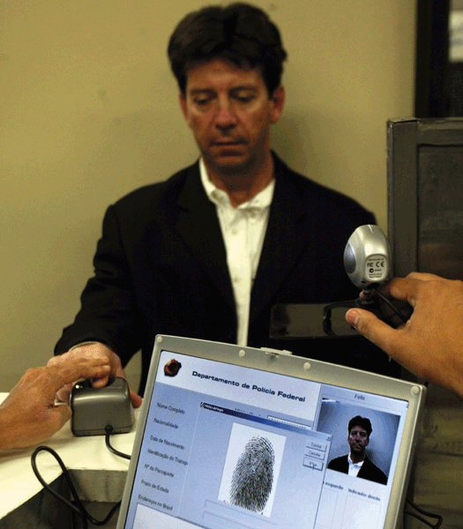
Unauthorized Access and Use
A possessed object is any item that you must carry to gain access to a computer or computer facility
Often are used in combination with a personal identification number (PIN)
A biometric device authenticates a person’s identity by translating a personal characteristic into a digital code that is compared with a digital code in a computer
Notes:
The card you use in an automated teller machine (ATM) is a possessed object that allows
access to your bank account.

Slide 23
Hardware Theft and Vandalism
Hardware theft is the act of stealing computer equipment
Hardware vandalism is the act of defacing or destroying computer equipment

Slide 24
Safeguards against Hardware Theft
Physical Security Measures
Access Control
Secure Storage
Security Alarms
Tracking and Identification
Asset Tracking
Device Identification
Data Encryption and Backup
Data Encryption
Regular Backups

Slide 25
Software Theft
Software theft occurs when someone:
Steals software media
Intentionally erases programs
Illegally copies a program
Illegally registers and/or activates a program

Slide 26
Software Theft
A single-user license agreement typically contains the following conditions:
Permitted to
Install the software on one computer
Not permitted to
Install the software on a network
Make one copy of the software
Remove the software from your computer before giving it away or selling it
Give copies to friends or colleagues while continuing to use the software
Export the software
Rent or lease the software

Slide 27
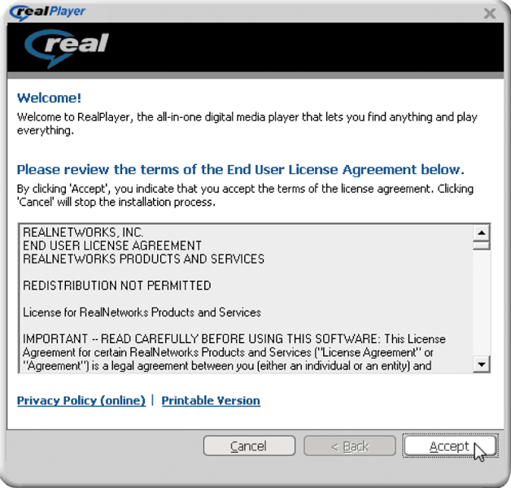
Software Theft
Copying, loaning, borrowing, renting, or distributing software can be a violation of copyright law
Some software requires product activation to function fully

Slide 28
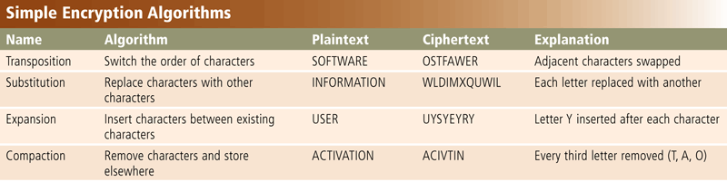
Information Theft
Information theft occurs when someone steals personal or confidential information
Encryption is a process of converting readable data into unreadable characters to prevent unauthorized access
Pages 572 - 5
Figure 11-17

Slide 29
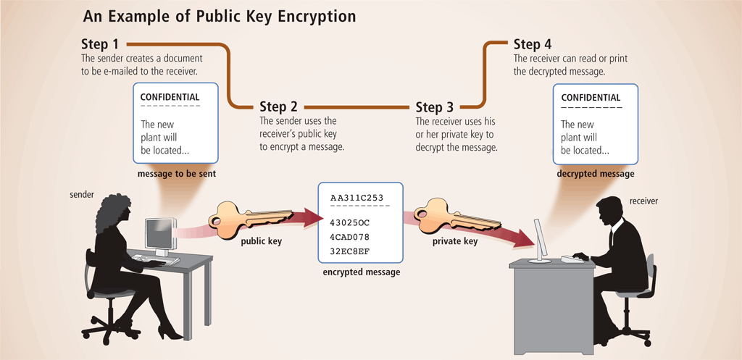
Information Theft

Slide 30
System Failure
A system failure is the prolonged malfunction of a computer
A variety of factors can lead to system failure, including:
Aging hardware
Natural disasters
Electrical power problems
Noise, undervoltages, and overvoltages
Errors in computer programs

Slide 31
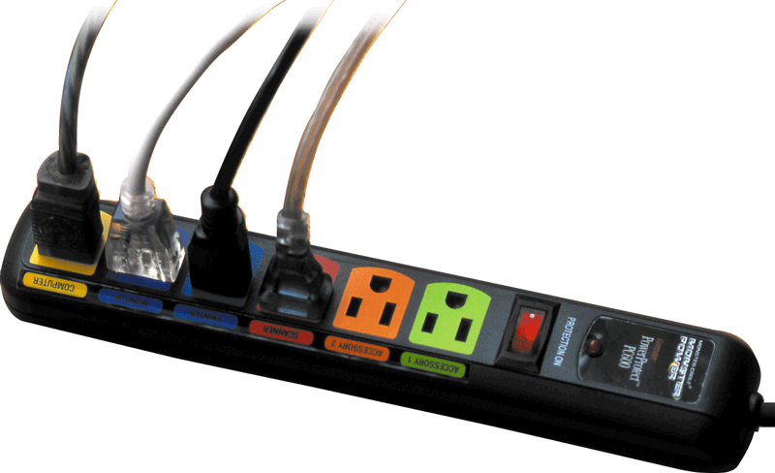
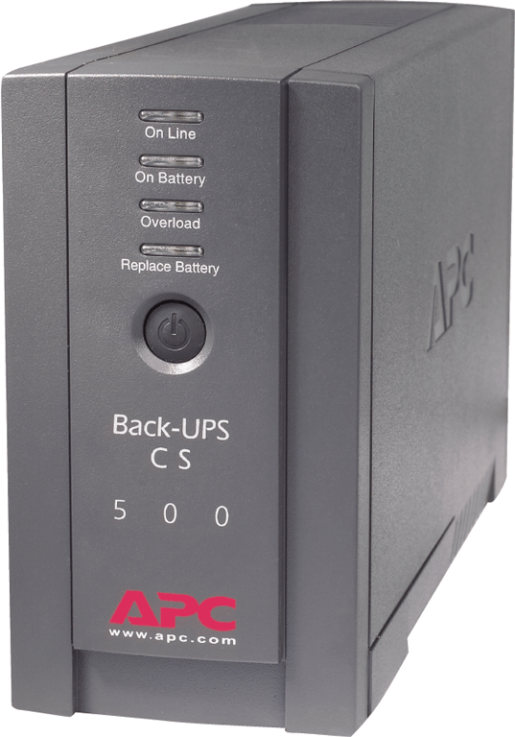
System Failure
Two ways to protect from system failures caused by electrical power variations include surge protectors and uninterruptable power supplies (UPS)

Slide 32
System Failure
A surge protector uses special electrical components to provide a stable current flow to the computer and other electronic equipment.
An uninterruptible power supply (UPS) is a device that contains surge protection circuits and one or more batteries that can provide power during a loss of power. A UPS connects between your computer and a power source.

Slide 33
Backing Up – The Ultimate Safeguard
A backup is a duplicate of a file, program, or disk that can be used if the original is lost, damaged, or destroyed
To back up a file means to make a copy of it
Offsite backups are stored in a location separate from the computer site
Cloud Storage

Slide 34
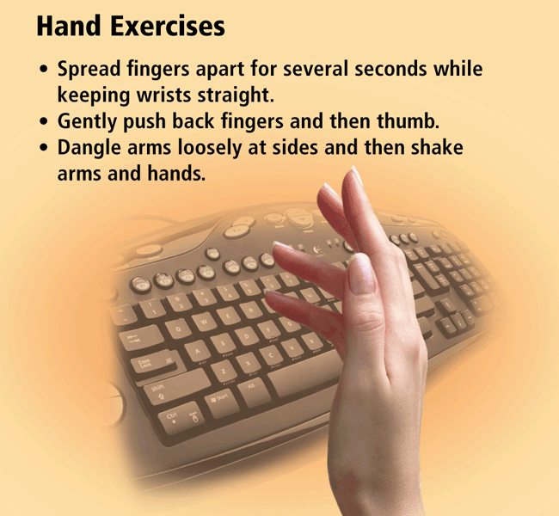
Health Concerns of Computer Use
The widespread use of computers has led to health concerns
Repetitive strain injury (RSI)
Tendonitis
Carpal tunnel syndrome
Computer vision syndrome (CVS)

Slide 35
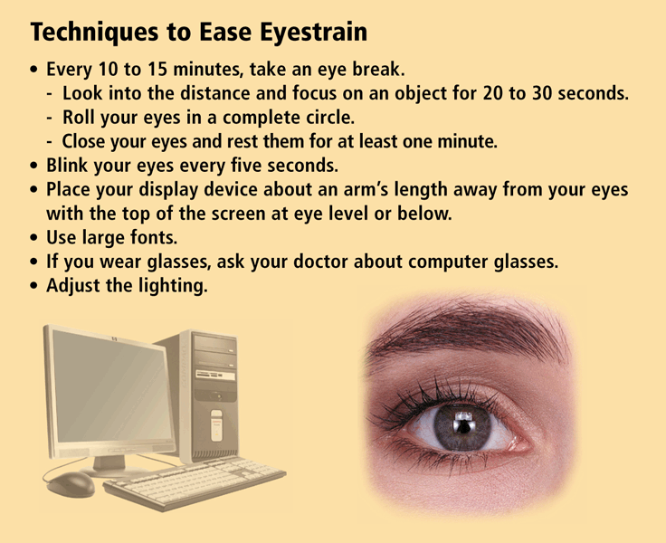

Slide 36
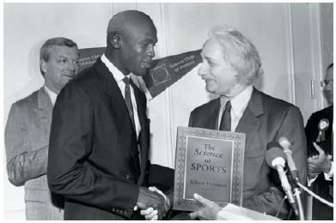
Ethics and Society
Computer ethics are the moral guidelines that govern the use of computers and information systems
Information accuracy is a concern
Not all information on the Web is correct

Slide 37
Ethics and Society
Intellectual property rights are the rights to which creators are entitled for their work
A copyright protects any tangible form of expression
An IT code of conduct is a written guideline that helps determine whether a specific computer action is ethical or unethical

Slide 38
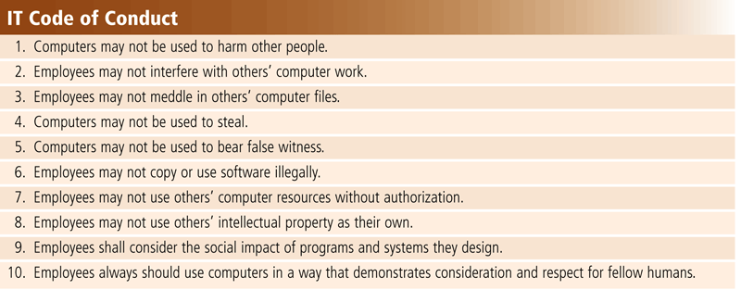

Slide 39
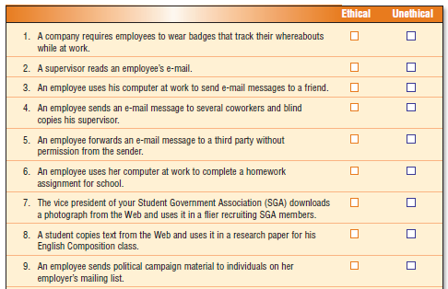
Ethics and Society

Slide 40
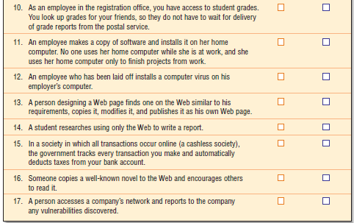

Slide 41
Ethics and Society
Information privacy refers to the right of individuals and companies to deny or restrict the collection and use of information about them
Huge databases store data online
It is important to safeguard your information

Slide 42
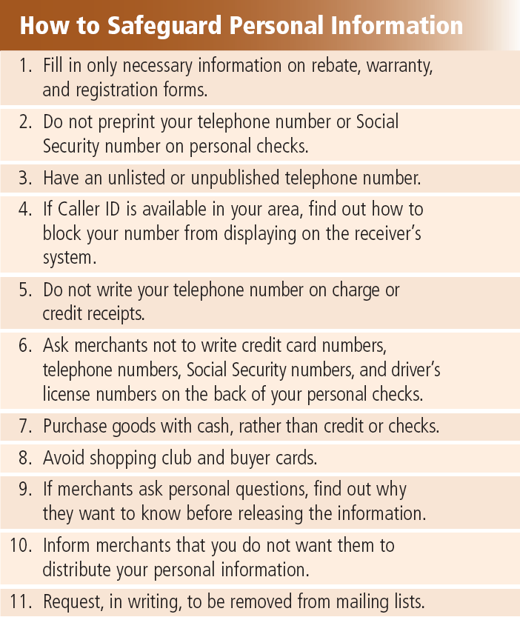

Slide 43
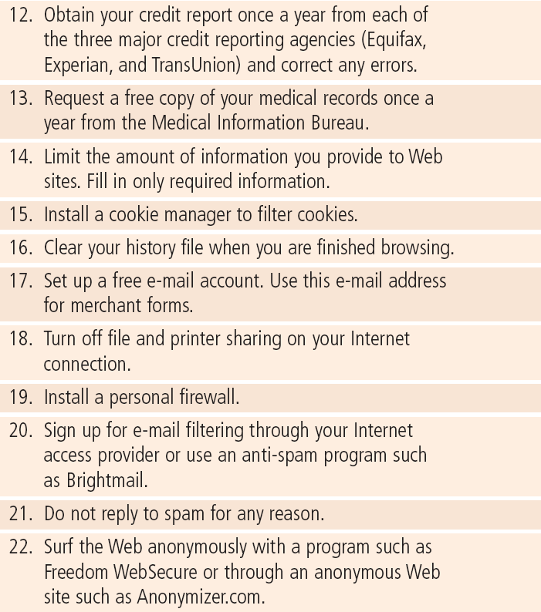

Slide 44
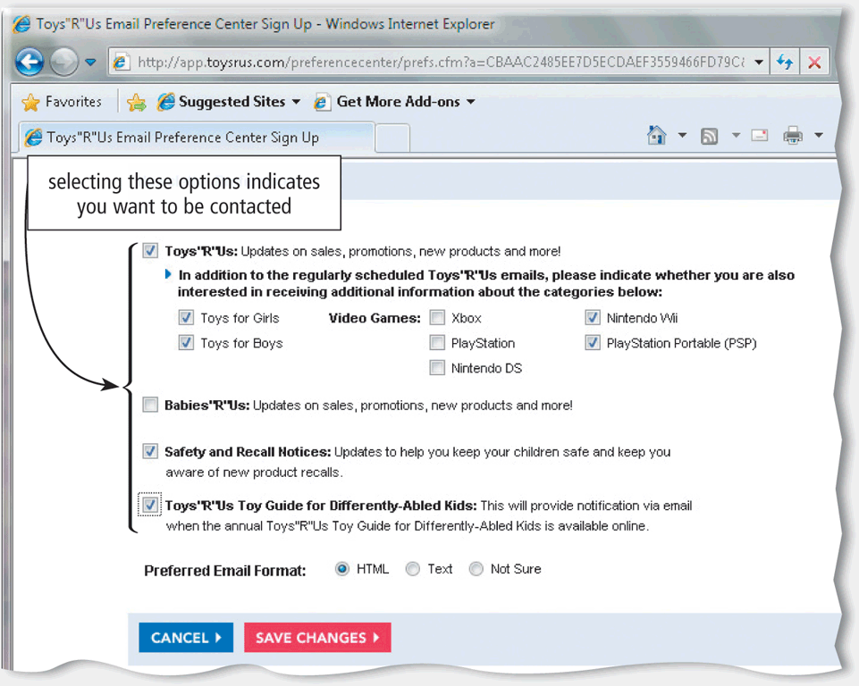
Ethics and Society
When you fill out a form, the merchant that receives the form usually enters it into a database
Many companies today allow people to specify whether they want their personal information distributed

Slide 45
Ethics and Society
A cookie is a small text file that a Web server stores on your computer
Web sites use cookies for a variety of reasons:
Allow for personalization
Store users’ passwords
Assist with online shopping
Track how often users visit a site
Target advertisements

Slide 46
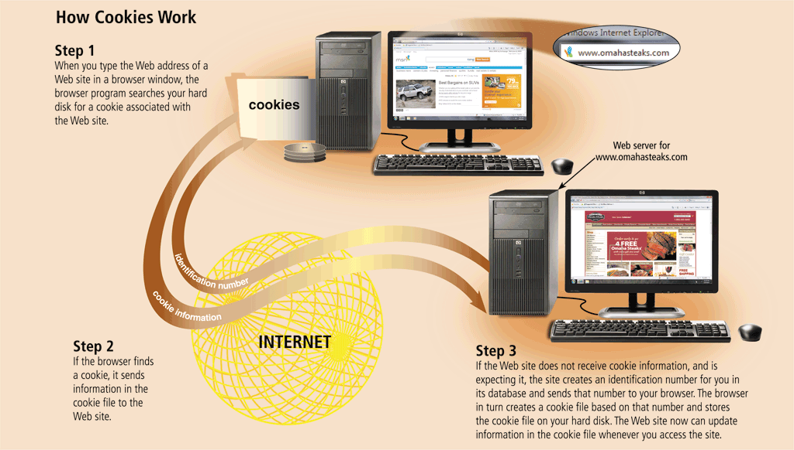
Ethics and Society

Slide 47
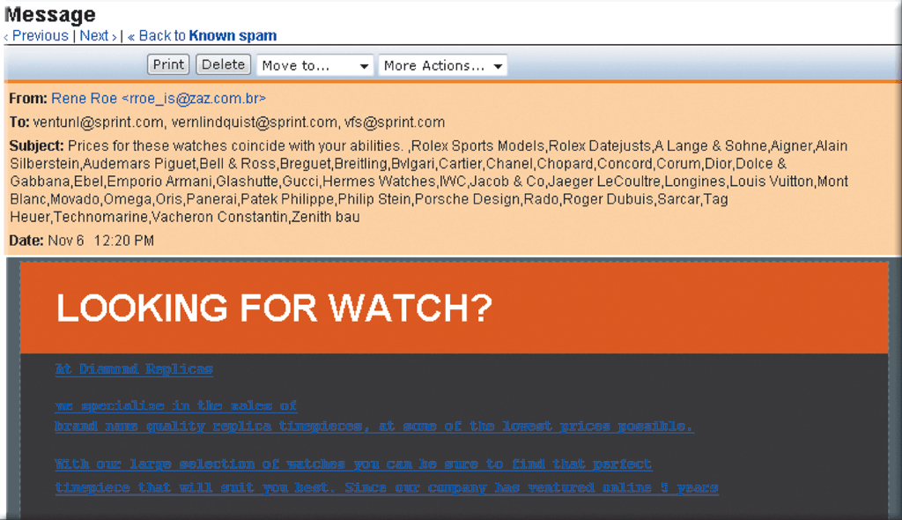
Ethics and Society
Spam is an unsolicited e-mail message or newsgroup posting
E-mail filtering blocks e-mail messages from designated sources
Anti-spam programs attempt to remove spam before it reaches your inbox

Slide 48
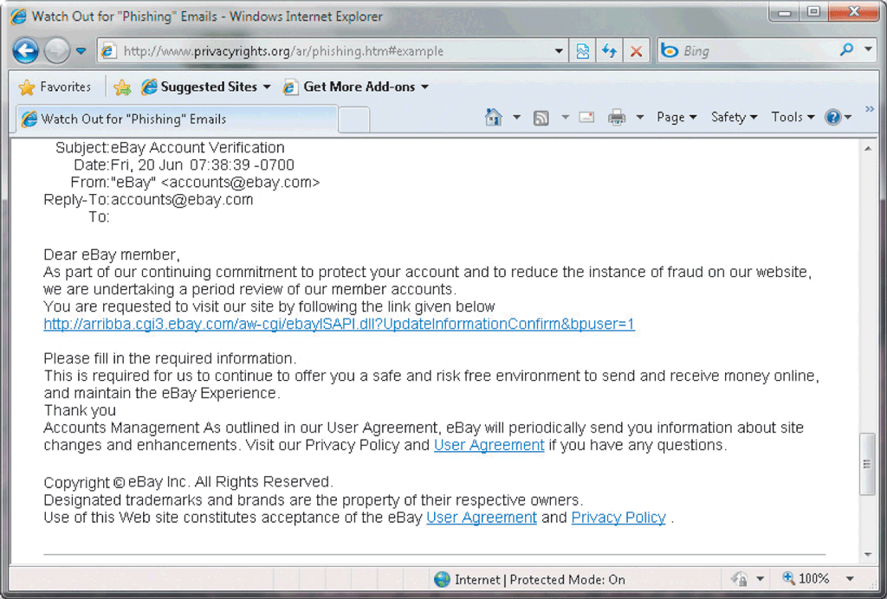
Ethics and Society
Phishing is a scam in which a perpetrator sends an official looking e-mail message that attempts to obtain your personal and financial information
Pharming is a scam where a perpetrator attempts to obtain your personal and financial information via spoofing

Slide 49
Ethics and Society
Social engineering is defined as gaining unauthorized access or obtaining confidential information by taking advantage of trust and naivety
Employee monitoring involves the use of computers to observe, record, and review an employee’s use of a computer

Slide 50
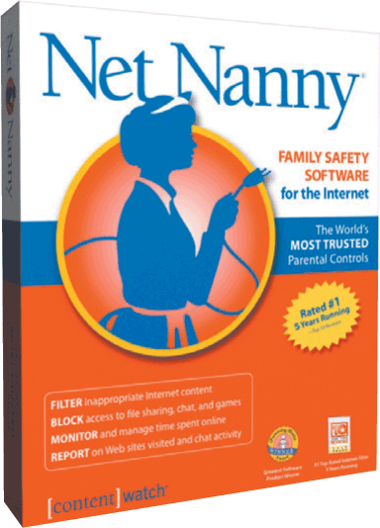
Ethics and Society
Content filtering is the process of restricting access to certain material on the Web
Many businesses use content filtering
Web filtering software restricts access to specified Web sites

Slide 51
Summary
Potential computer risks and safeguards
Wireless security risks and safeguards
Computer-related health issues and preventions
Ethical issues surrounding information accuracy, intellectual property rights, codes of conduct, green computing, and information privacy

